Slide 1


Introduction to the Study of Word Meaning
Notes:
Say: Welcome! Today we’re going to start looking at words in a whole new way. This will help us see connections between words, help us remember new words, and even help our spelling! I’m going to give you a handout, and any time you see this image in a corner of the slide, it’s an indication that you will need to pause and take notes.
Do: Provide student handout, but do NOT give them the answer key on the last page.

Slide 2
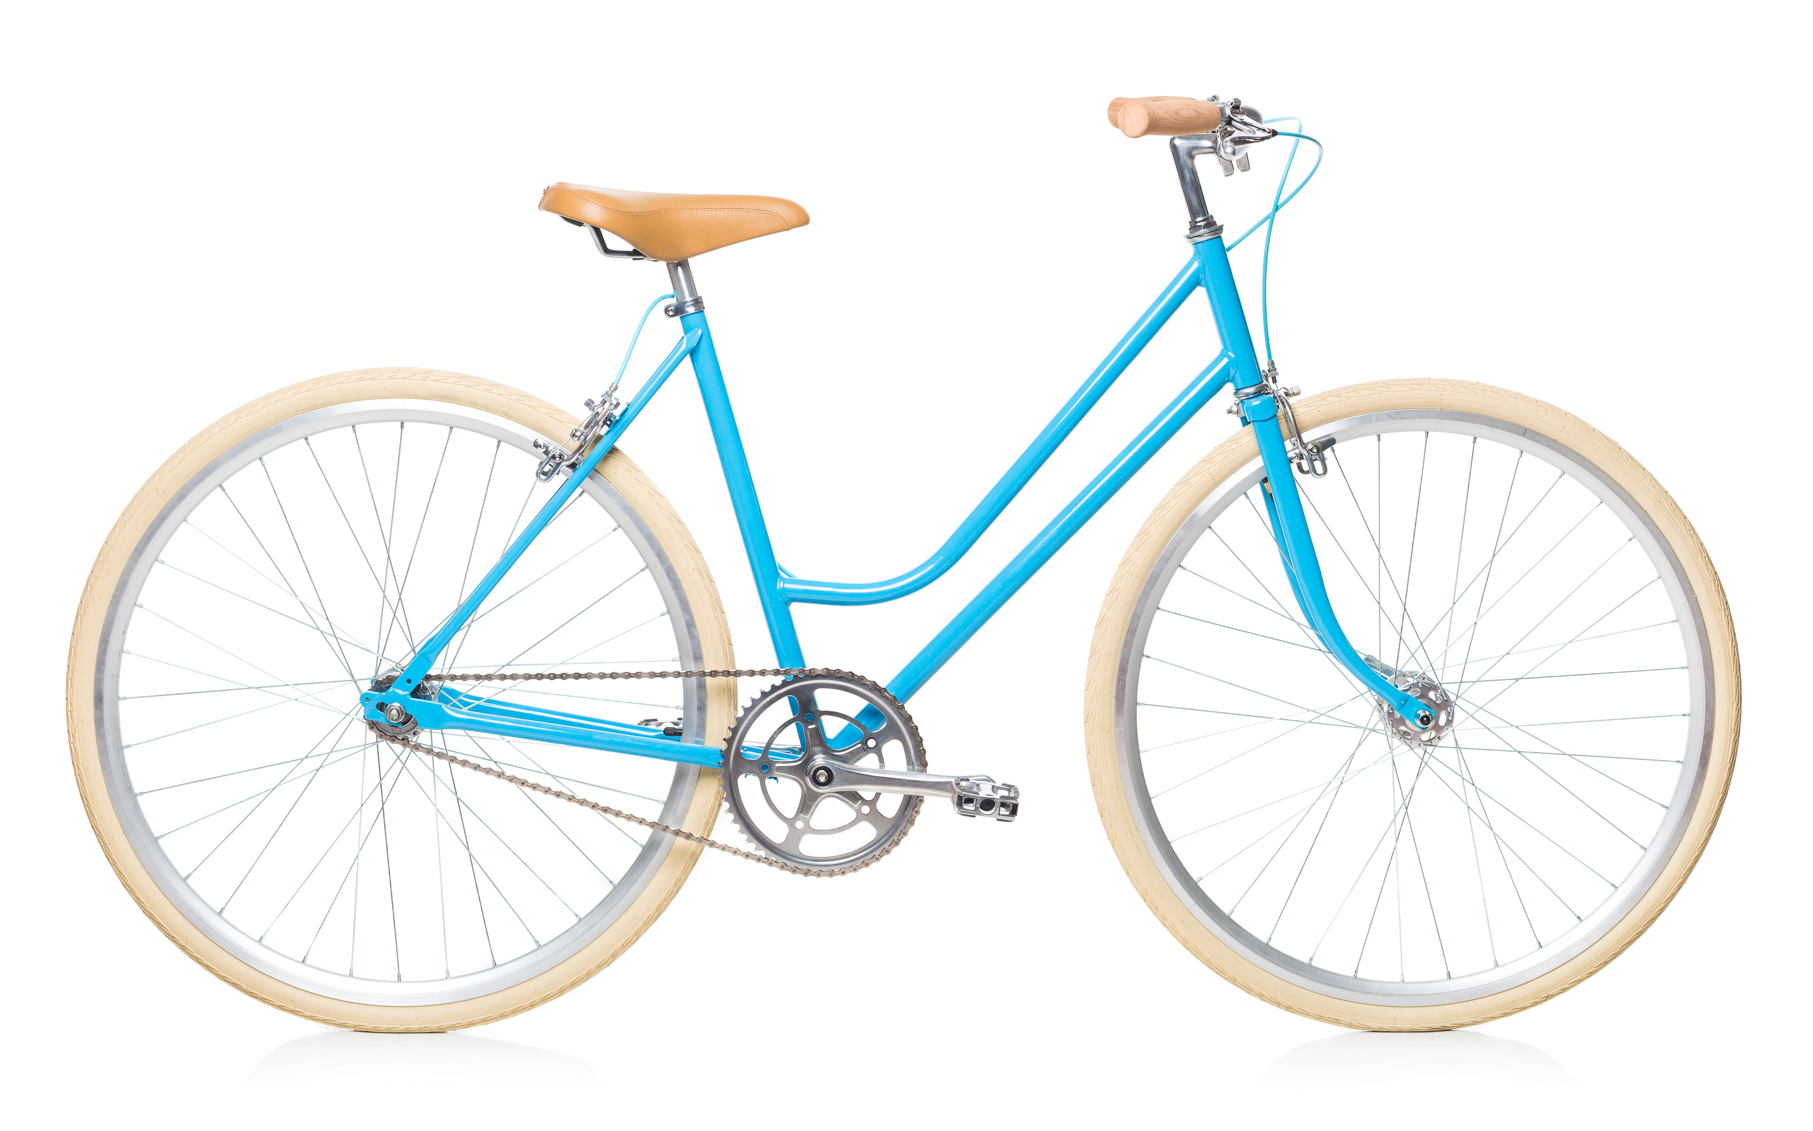
What is this a picture of?
Why is it called a bicycle and not a doodle, or a tricycle?
Notes:
Do: Read slide and ask students for responses. We want them to think about why things are called what they are.

Slide 3
bi = two cycle = circle
bicycle= two circles
Notes:
Say: Bi- means two and cycle means circle. So we call it bicycle which means two circles. So, if I am ”bilingual” how many languages do I know? (two). How many wheels would a tricycle have? (three). As parts of the words change the meanings of the words change.

Slide 4
Words are made up of meaningful parts called morphemes.
Example: bicycle has two parts that have meaning.
two
circle
It has two morphemes.
Notes:
Do: Read slide and pause for students to take notes.

Slide 5
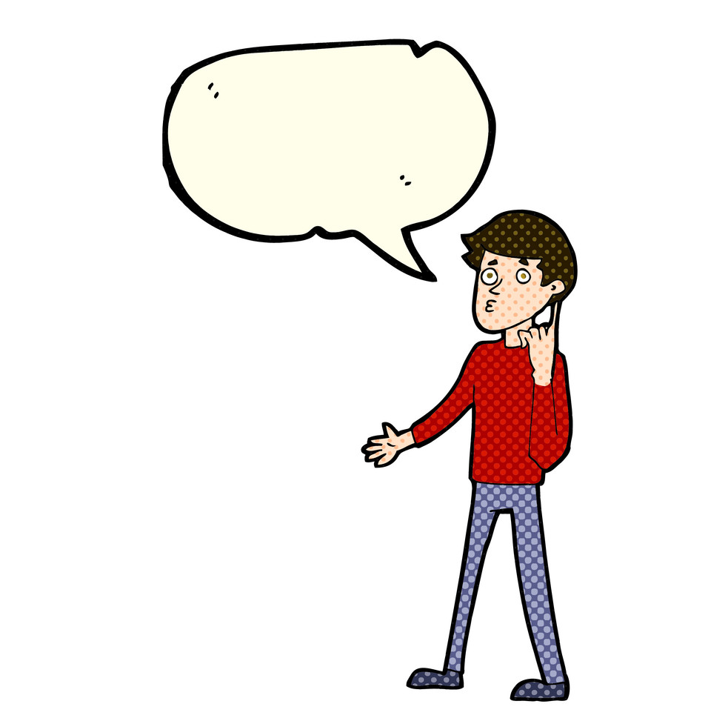
A morpheme has meaning. Let’s decide if these are morphemes or not.
book
ch
bi
o
cycle
carve
lk
morpheme
not a morpheme
Does it have
meaning?
morpheme
not a morpheme
morpheme
morpheme
not a morpheme
Notes:
Do: Read the slide discuss each word and click animation.

Slide 6



Some words have only one morpheme. For example:
Notes:
Do: Read slide and do not let students confuse morphemes (meaningful parts) with syllables (1 vowel sound).

Slide 7
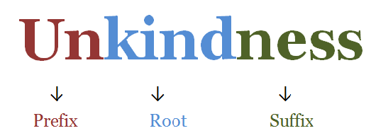
Some words have more than one morpheme:
Notes:
Do: Read slide and do not let students confuse morphemes (meaningful parts) with syllables (1 vowel sound).

Slide 8
How many morphemes are in these words?
1 | 2 | 3 | Not a morpheme
listen
sunshine
books
lovely
bi
disliking
ack
walk
Arizona
bicycle
ch
Directions: Move the words into the correct box.
Notes:
Do: Leave presenter view and move words into the correct boxes discussing with students why each word belongs in the corresponding box (answer key on next slide).

Slide 9
A word can have 1 or more morphemes:
1 | 2 | 3 | Not a morpheme
Arizona | bicycle | disliking | ack
walk | lovely |  | ch
bi | books
listen | sunshine
Please come up with your own examples.
Notes:
Do: Have students add some examples to their notes.

Slide 10
Free Morphemes make sense by themselves or stand alone.
Free Morphemes
jump
look
run
girl
house
Let’s think of one more example of a
free morpheme.
Notes:
Do: Read the slide and have students add to their notes (#3).

Slide 11
Bound morphemes need to be attached to another morpheme to make a word.
Free Morphemes | Bound Morphemes | Words we Made
jump | ing
look | s
run | er
girl | ly
like | dis
friend | bi
trust | cep
Try to attach the bound morphemes to the free morphemes to make some words OR attach two bound morphemes together.
Notes:
Do: Read the slide and have students add to their notes (#4). Leave presenter view and type student responses in the box, or if projecting onto a whiteboard/smartboard have students write their own responses.

Slide 12
Let’s make sure we have 1-4 filled out in our notes!
Notes:
Optional: You may wish to stop here, if it seems that this was a lot of new information for students.

Slide 13
Roots carry the main meaning of a word.
motorcycle
recycle
unicycle
bicycle
tricycle
cycles
cyclers
Challenge: Is “cycle” a free or bound morpheme?
(Answer on next slide)
Notes:
Do: Read slide and have students fill out #5.

Slide 14
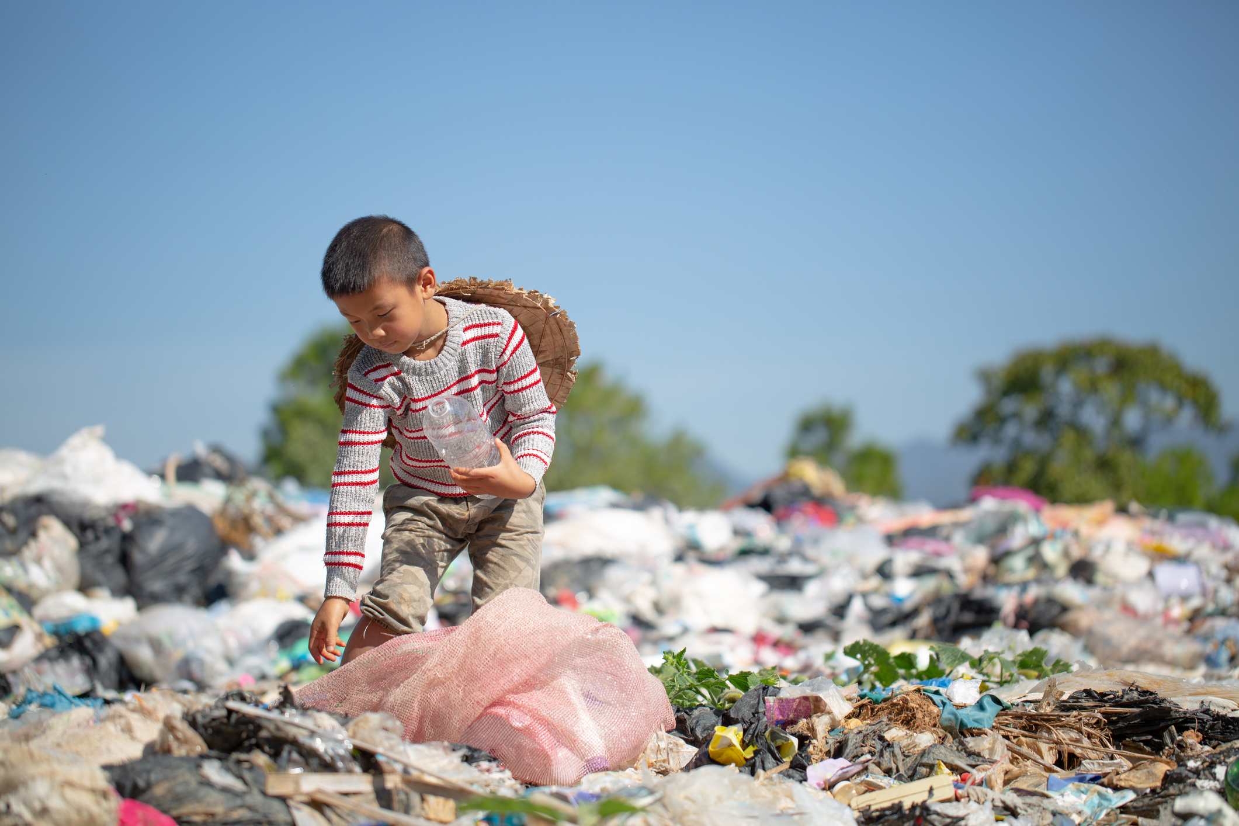
Sometimes roots will be free morphemes like “cycle.” Example: The country is trapped in a cycle of poverty.
Notes:
Do: Read slide.

Slide 15

Sometimes they will be bound morphemes, like “fer.” Example: Some teachers prefer smaller class sizes.
Notes:
Do: Read slide.

Slide 16
returning biceps
We may know the root (base, base word), like in returning.
free morpheme
bound morpheme
Or we might not know it like the root (base, base
word) in biceps.
Notes:
Do: Read slide.

Slide 17
We can add prefixes or suffixes to roots to make many new words!
Prefixes (at the beginning)
infer
defer
confer
prefer
Suffixes (at the end)
inference
deferential
conference
preferable
Notes:
Do: Read slide.

Slide 18
Prefixes give meaning in three main ways:
Negative Like adding ”not” | Directional Gives a word direction | Intensifying Like adding “very”
like to dislike important to unimportant | play to replay marine to submarine | exhausted (ex=very haust=drained)
Suffixes don’t change the meaning as often as prefixes do.
Notes:
Say: Prefixes are responsible for giving meaning more so than suffixes. Typically they give meaning in three ways.

Slide 19
Use the PowerPoint pen to match the term with the definition:
morpheme
bound
free
root, base, base word
prefix
suffix
A morpheme that goes at the beginning
A morpheme that goes at the end
A morpheme that can stand alone
The smallest unit of meaning
A morpheme that cannot stand alone
A morpheme that carries the main meaning of a word.
Notes:
Do: Ask the class to match the term with the definition. And fill out 8-10 in their notes.
Discuss the answers:
4, B. 5, C. 3, D. 6, E. 1, F. 2

Slide 20
Morphemes have meaning!
Morphemes
Prefixes
un
Roots
kind
Suffixes
ness
the act of being
kind
not
We are going to learn how to use morphemes to figure out unknown words!
Notes:
Say: Now that we’ve learned about morphemes and how they make up words, we’re going to start using morphemes to figure out unknown words that we see or hear.

Slide 21
Bingo Review Game Use the following word list to make your own bingo card. Put a word in each square in any order.
1. morpheme
2. root
3. prefix
4. suffix
5. free morpheme
6. bound morpheme
7. base, base words
8. Example: ch
9. Example: runs
10. Example: ing
11. Example: microwave
12. Example: unkindness
Notes:
Do: Have students make their own bingo cards by putting the terms in any order on their handout. Show next slide for sample.

Slide 22
Sample Bingo Card Filled Out
1. morpheme
2. root
3. prefix
4. suffix
5. free morpheme
6. bound morpheme
7. base, base words
8. Example: ch
9. Example: runs
10. Example: ing
11. Example: microwave
12. Example: unkindness
morpheme | microwave | ing | root
unkindness | ch | runs | prefix
Base, base words | bound morpheme | free morpheme | suffix

Slide 23
Caller Prompts (not for display) Students win by getting three in a row!
1. morpheme- the smallest unit of meaning.
2. root- carriers the main meaning of a word, OR ”cycle” is an example of this.
3. prefix- a morpheme that goes at the beginning.
4. suffix- a morpheme that goes at the end.
5. free morpheme- a morpheme that can make sense alone.
6. bound morpheme- a morpheme that needs to be attached to another morpheme to make a word.
7. base, base words- sometimes people call roots _____________.
8. Example: ch- an example of something that is not a morpheme.
9. Example: runs- an example of a word with two morphemes.
10. Example: ing- an example of a bound morpheme.
11. Example: microwave- an example of word with two morphemes
12. Example: unkindness- an example of a word with three morphemes.
Notes:
Do: Use these as your caller prompts, but do not display.

Slide 24
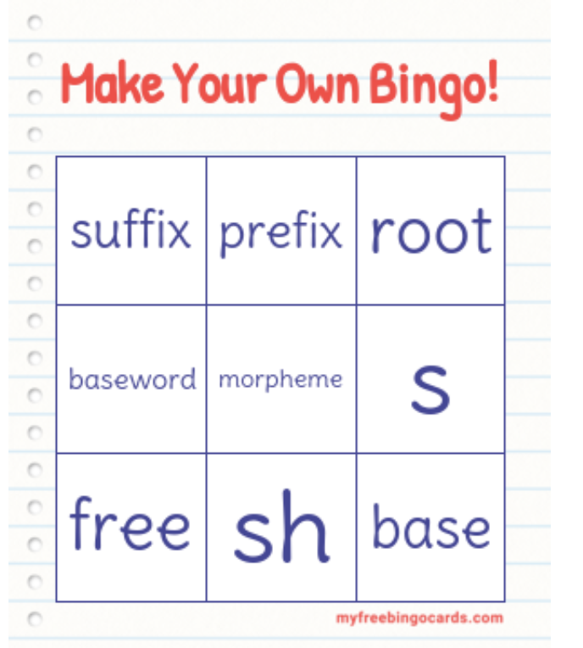
Create a set of 30 Bingo Cards for Free www.myfreebingocards.com
Notes:
Do: Alternatively, create bingo cards for your students using this website.

Slide 25




The contents of this presentation were developed under a State Personnel Development Grant (SPDG) from the US Department of Education (CALI/Award #H323A170011), Project Officer, Latisha.Putney@ed.gov. However, the contents of this presentation do not necessarily represent the policy of the US Department of Education and no assumption of endorsement by the Federal government should be made.

